Slide 1
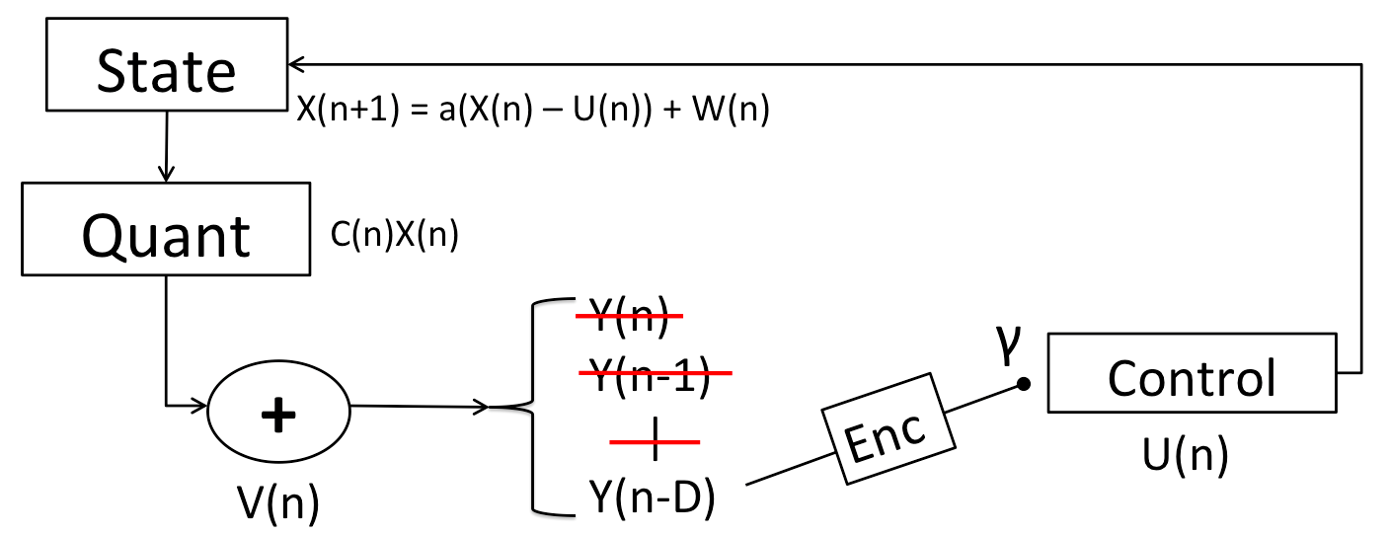
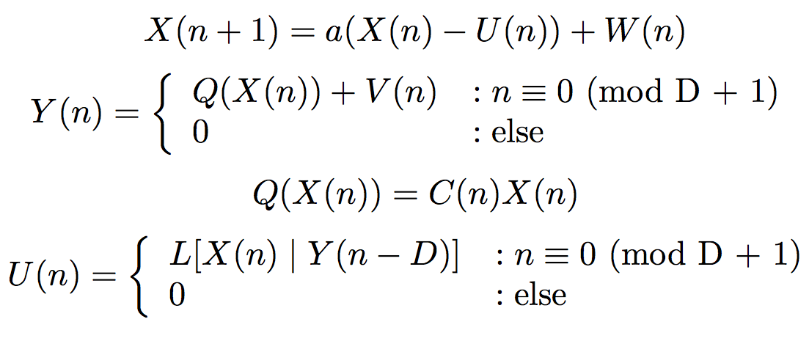
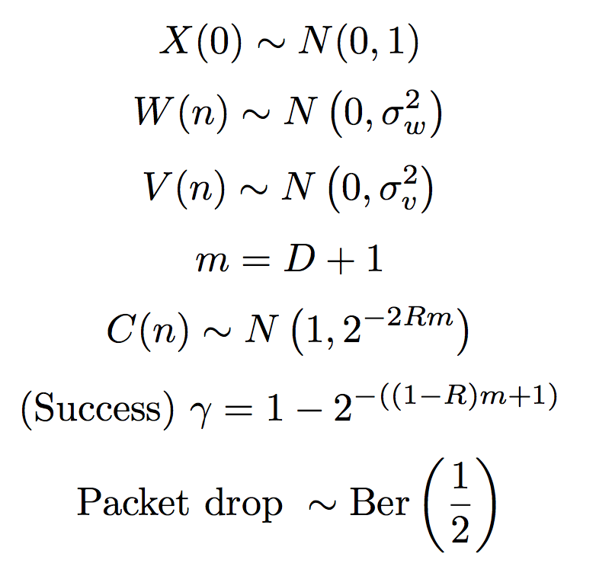



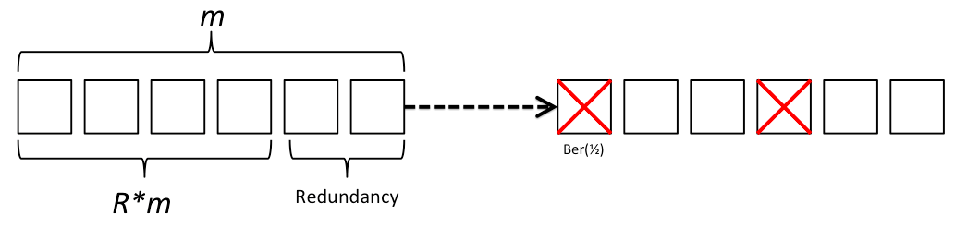
Delay in Control Systems
Leah Dickstein, Gireeja Ranade, Anant Sahai
Department of Electrical Engineering and Computer Science, University of California--Berkeley
ABSTRACT
RESULTS
CONCLUSIONS
Communication channels are embedded in all technologies, and delay is present in all real-world channels. In control systems, the plant is growing increasingly unstable as time passes. The plant needs regular feedback from the controller in a short timeframe, and delay will increase the instability of the system. In contrast, delay means we are sending more bits across a channel before doing anything, which leads to higher precision in the message and higher reliability of decoding success. In this case, delay increases the stability of the system. Furthermore, the message encoding rate determines the message’s precision and reliability. Our study is exploring the relationship between delay and system stability through various control and encoding strategies.
Instantaneous control is best
Real-world applications D >= 1
Performance of the system improves asymptotically:
We don't need to achieve infinite delay to reap all possible benefits
Jaggedness of the plot stems from the discrete nature of the packet drop model
Optimal encoding rate R asymptotically decays as delay increases, converging to 0.34
Figure 1
Instantaneous control/communication is best, but delay is asymptotically good if D > 1
Figure 2
Simulation
FUTURE WORK
SYSTEM DYNAMICS
Refining our model further
Nonlinear or memory-based control strategies
Generalizing beyond Reed-Solomon codes
“Buffering” vs. “Streaming” delay
Further exploration of ‘finite blocklength’ effects
REFERENCES
[1] Shannon “A Mathematical Theory of Communication” 1948.
[2] Gireeja Ranade and Anant Sahai. Non-Coherence in Estimation and Control. Allerton 2013.
[3] S.Dey, A. Chiuso, L. Schenato. Remote estimation with noisy measurements subject to packet loss and quantization noise. Automatica 2013
Figure 3
Optimal encoding rate decays and converges to ~0.34
Figure 4
Encoding rate changes as delay increases
CONTACT
Figure 5
Graphical representation of the decay of the variance of C(n), E[C²(n)] – E[C(n)]²
Figure 6
Graphical representation of the decay of drop probability, 2^{-((1-R)*code + 1)}
Leah Dickstein
leahdickstein@berkeley.edu
Gireeja Ranade
gireeja@eecs.berkeley.edu
Anant Sahai
sahai@eecs.berkeley.edu

